Slide 1
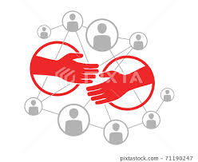
Chapter 5
Networking

Slide 2
Chapter Overview
Introduction
Email and spam
Fighting spam
World Wide Web
Ethical perspectives on pornography

Slide 3
Chapter Overview
Censorship( control)
Freedom of expression
Children and the Web
Breaking trust on the Internet
Internet addiction ادمان الانترنت

Slide 4
Introduction
Networking increases computer’s utility
In addition to Word processing, Excel, …etc, you can share printers, extra storage, exchange data, e-mail.
Internet connects millions of computers
Powerful computational resource
E-mail, surfing www, promoting your company.
Even more powerful communication medium
Network utility grows as number of users squared
As people grows
Network may suffer overload
people may act irresponsibly

Slide 5
How Email Works
Email: Messages embedded in files transferred between computers
Email address: Uniquely identifies cyberspace mailbox (2-parts User….@ Domain....)
Messages broken into packets
Routers transfer packets from sender’s mail server to receiver’s mail server

Slide 6
The Spam Epidemic
Spam: Unwelcome, bulk Email
Amount of email that is spam has increased
8% in 2001
40% in 2003
75% in 2007
90% in 2009
Spam is effective (Cheap way for Ads. It costs $500 - $2000 to a million e-mail address)
A company hires an internet marketing firm to send thousands of emails
More than 100 times cheaper than “Junk (traditional) mail”
Profitable even if only 1 in 100,000 buys product

Slide 7
The Spam Epidemic
How firms get email addresses
Opt-in lists (voluntarily revealing them in contests to get offers) قوائم الاشتراك (الكشف عنها في مسابقات للحصول على عروض)
Viruses gather them from PCs address books.
Dictionary attacks
Spammers seek privacy (bots and zombies)
Change email and IP addresses to mask sending machine
Capture another insecure system as a spam launch pad
التقاط نظام غير آمن كمنصة إطلاق البريد العشوائي
Spam blockers
Attempt to screen out spam (spam filters) by blocking suspicious subject lines. محاولة حجب الرسائل غير المرغوب فيها (.

Slide 8
Fighting Spam: Real-Time مكافحة البريد العشوائي Blackhole List
Trend Micro contacts marketers who violate ينتهكون standards for bulk email مجموعة الايميلات
( a DB of IP addresses that make spam. Trend Micro sells this DB to organizations)
Unsecured mail servers that have been hijacked مستولى عليها may be regarded as spammers and they will be blocked even if they are not spammers)
يمكن اعتبارهم مرسلي بريد عشوائي وسيتم حظرهم حتى لو لم يكونوا مرسلي بريد عشوائي

Slide 9


Slide 10
Ethical Evaluations of Publishing Blacklist
Social contract theory evaluation
Senders and receivers do not derive equal benefit from emails.
Utilitarian evaluation
Blacklisting will affect innocent الابرياءusers, receivers and marketing firms, this will reduce the benefits of internet utility as a whole.
Kantian evaluation
Innocent users are used as a means for an end (eliminating spams) القضاء عليه
Inecent ابرياء

Slide 11
Proposed Solutions to Spam Epidemic
Require an explicit opt-in of subscribersاشتراك صريح
Require labeling of email advertising (all commercial emails must write ADS on the subject line)
Add a cost to every email that is sent for ads. A micropayment systems is proposed
Ban unsolicited email by laws حظر البريد الإلكتروني غير المرغوب فيه بموجب

Slide 12
Emergence of “Spam” "هي رسالة فورية مجمعة غير مرغوب فيها.
“Spam” is an unwanted, bulk instant message. رسائل فورية مجمعة.
People combatيحارب spam by accepting messages only from friends or buddiesمعارف

Slide 13
Need for Socio-Technical Solutions
New technologies sometimes cause new social situations to emerge
Spam an example of this phenomenon
Email messages practically free.
Profits increase with number of messages sent.
Strong motivation to send more messages.
Internet design allows unfair, one-way communications – You might receive e-mail But you cannot reply.

Slide 14
Attributes of the Websites
It is decentralized
No need for central authority
BUT it becomes difficult to control the Web
Every Web object has a unique address
URL. Every Web page has a unique URL
It is based on the Internet
It needs browsers, media for storage, SW for retrieving data, ftp, OSs…etc.

Slide 15
How We Use the Web
Shopping
Contributing content (wikis, blogs)
A wiki is a website that allows the easy creation and editing of any number of interlinked web pages via a web browser using a simplified markup language. Collaborative site – many authors
An individual with regular entries of commentary usually maintains blogs. Personal site (Ex: online journal).Promoting business
Learning.
Entering virtual worlds.
Paying taxes( E-Government).
E-commerce.
Entertainment

Slide 16
Too Much Control or Too Little?
Not everyone in the world has Internet access.
Saudi Arabia: centralized control center
People’s Republic of China: ISPs sign “self-discipline” agreement "الانضباط الذاتي"
Germany: Forbids access to neo-Nazi sites النازيين الجدد
United States: Repeated efforts to limit access of minors to pornography.التحرش وانتهاكات الطفولة

Slide 17
Direct Censorship
Censorship is the attempt to suppress or regulate public access to material considered offensive or harmful.
Direct Censorship Forms:
Government domination سيطرة
TVs, Newspapers and radio stations
Prepublication review مراجعة ما قبل النشر
To monitor government secrets (Nuclear weapons)
Licensing and registration الترخيص والتسجيل
To control media with limited bandwidth. (Frequencies)

Slide 18
Self-censorship
Most common form of censorship:
The group decides for itself not to publish(رقابة ذاتية)
Reasons
Avoid subsequent persecution (CNN in Iraq)
تجنب الاضطهاد اللاحق
Maintain good relations with government officials (if they offend the government they lose their official sources of information) الحفاظ على علاقات جيدة مع المسؤولين الحكوميين (إذا أساءوا)
Movies, TVs, CD
Ratings systems
s, video games
Not universally accepted on the Web (some may have warning– and ask for agree to enter a site)

Slide 19
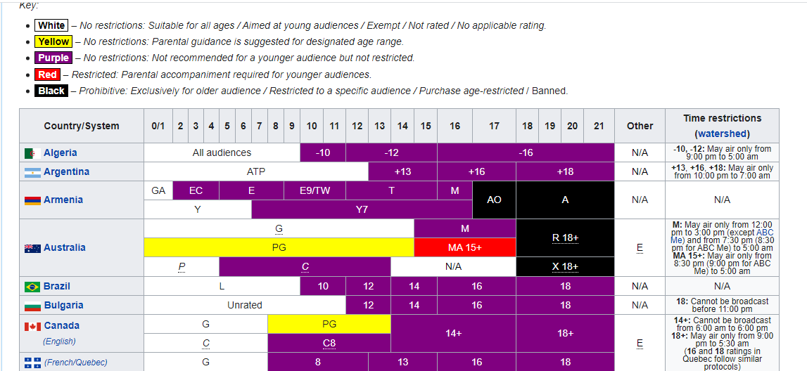

Slide 20
Challenges Posed by the Internet
Many-to-many communication
It is easy to close a radio station BUT difficult to do so for a Web page (millions can post pages)
Dynamic connections
Millions of PCs are connected to internet yearly
Huge numbers of Web sites
No way to monitor them all.
Extends beyond national borders, laws يمتد إلى ما وراء الحدود الوطنية
Can’t determine age of users
an adult Web site can not confirm the age of a user

Slide 21
Ethical Perspectives on Censorship
Kant opposed censorship عارض
Enlightenment thinker تنويري
“Have courage to use your own reason”
Mill opposed censorship
No one is infallible معصوم
Any opinion (not the majority opinion) may contain a kernel نواة of truth (a part of the whole truth).

Slide 22
Mill’s Principle of Harm
“The only ground on which intervention التدخل
is justified is to prevent harm to others; the individual’s own good is not a sufficient condition.”
When individual’s act harms others the government must intervene.
في حالة إيذاء الآخرين على الحكومة ان تتدخل

Slide 23
Freedom of Expression: History
18th century
England and the colonies: No prior restraints on publication
People could be punished for sedition or libel
القرن ال 18
إنجلترا والمستعمرات: لا قيود مسبقة على النشر
يمكن معاقبة الناس على الفتنة أو الشتم
American states adopted bills of rights including freedom of expression.
Freedom of expression in 1st amendment to U.S. Constitution
addressed this issue – to discuss public issues.
تناولت حرية التعبير في التعديل الأول لدستور الولايات المتحدة هذه القضية - لمناقشة القضايا العامة

Slide 24
Freedom of Expression not an Absolute Right
1st Amendment covers political and nonpolitical speech (as scientific speech, art).
Right to freedom of expression must be balanced against the public good. (not absolute)
Various restrictions on freedom of expression exist (for the public good): للصالح العام
ban of cigarette advertising on TV حظر

Slide 25
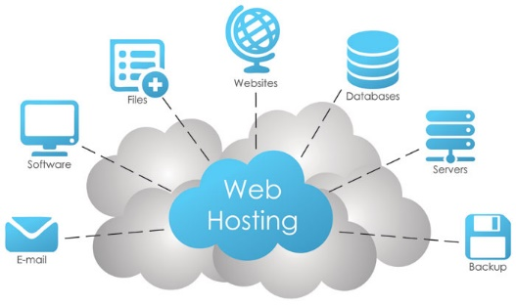
Children and the Web: Web Filters
Web filter: software that prevents display of certain Web pages (pornographic or violent) إباحي أو عنيف
May be installed on an individual PC
ISP may provide service for customers.
An Internet service provider (ISP) is a company that provides web access to both businesses and consumers.
ISPs may also provide other services such as email services, domain registration, web hosting, and browser services.
Methodologies
Maintain “black list” of objectionable sites مواقع مرفوضة
Before downloading a page, examine content for objectionable words/phrases
Child Internet Protection Acts started to arise

Slide 26
Breaking trust on the Internet: Identity Theft
Identity theft: when a person uses another person’s electronic identity.
More than 1 million Americans were victims of identity theft in 2008 due to their online activities
Phishingتصيد: use of email or Web pages to attempt to deceive خداع people into revealing personal information.
للكشف عن معلومات شخصية.
(a fake PayPal site asking you to disclosure of info. Because your card is about to expire) كشف المعلومات

Slide 27
Chat Room Predatorsمفترسون
Chat room: supports real-time discussions among many people connected to network
Messenger, snap, WhatsApp, telegram, teams, BOTIM....etc.
Some pedophiles meet through chat rooms. (first case 1995- 1998)
Police countering with “sting” operations
Policemen enter chat rooms to lure pedophiles."
يدخل رجال الشرطة غرف الدردشة لإغراء المتحرشين بالأطفال.

Slide 28
False Information
Quality of Web-based information varies widely
Moon landings.
Holocaust.هولوكوست
Google attempts to reward quality
Keeps a DB of 8 million web pages.
Ranking Web pages uses “voting” algorithm
If many links point to a page, Google search engine ranks that page higher.

Slide 29
Is Internet Addiction Real? ادمان
Traditional definition of addiction:
Compulsive use of harmful substance or drug
استخدام قهري لشيء ضار ومؤذي
Knowledge of its long-term harm (misuse)
Kimberly Young created test for Internet addiction
(8 questions on gambling on the Net)
(5 “yes” ------- means addiction)
Her test is controversial
ابتكر كيمبرلي يونغ اختبارًا لإدمان الإنترنت
(8 أسئلة عن المقامرة على الإنترنت)
("نعم" ------- تعني الإدمان)
اختبارها مثير للجدل

Slide 30
Contributing Factors to Computer Addiction
Social factors
Peer groups
Situational factors
Stress
Lack of social support
Limited opportunities for productive activity
Individual factors
Tendency to follow activities to excess متابعة زائدة
Lack of achievement.
Fear of failure.
A feeling of isolation وحدة وغربة

Slide 31


